Slide 1
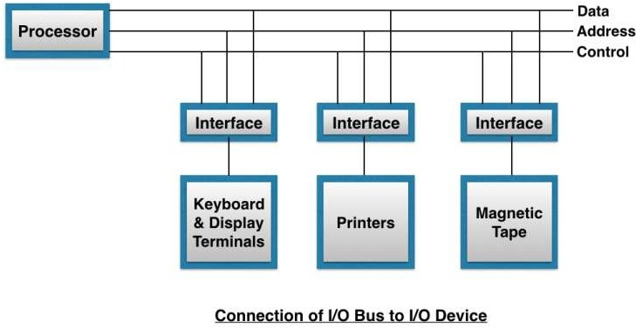
Unit: 4
Input-Output Organization Lecture-2
I/O Interface
Interface is a shared boundary between two separate components of the computer system which can be used to attach two or more components to the system for communication purposes.
There are two types of interface:
CPU interface
I/O interface
Input-Output Interface:
Peripherals connected to a computer need special communication links for
interfacing with CPU. In computer system, there are special hardware
components between the CPU and peripherals to control or manage the input- output transfers. These components are called input-output interface units because they provide communication links between processor bus and peripherals. They provide a method for transferring information between internal system and input-output devices.
The purpose of the communication link is to resolve the differences that exist between the central computer and each peripheral. The major differences are:
Peripherals are electromechanical and electromagnetic devices and their manner of operation is different from operation of CPU and memory, which are electronic devices. Therefore, a conversion of signal values may be required.
The data transfer rate of peripherals is usually slower than the transfer rate of CPU, and consequently , a synchronization mechanism may be needed.

Slide 2
Data codes and formats in peripherals differ from word format in the CPU and memory.
The operating modes of peripherals are different from each other and each must be controlled so as not to disturb the operation of other peripherals connected to CPU.
To resolve these differences, computer systems include special hardware components between the CPU and Peripherals to supervises and synchronizes all input and out transfers. These components are called Interface Units because they interface between theν processor bus and the peripheral devices.
The main function of input-output interface circuit are:
Data conversion:
  Data conversion refers to conversion between digital and analog signals and conversion between serial and parallel data formats.
Synchronization:
  Synchronization refers to matching of operating speed of CPU and other peripherals.
Device selection:
  Device selection refers to the selection of I/O device by CPU in a queue manner.
A typical communication link between the processor and several peripherals is shown in fig above.
The I/O bus consists of data lines, address lines and control lines.
The I/O bus from the processor is attached to all peripherals interface.
To communicate with a particular device, the processor places a device address on address lines.
Each Interface decodes the address and control received from the I/O bus, interprets them for peripherals and provides signals for the peripheral controller. It is also synchronizes the data flow and supervises the transfer between peripheral and processor.
Each peripheral has its own controller. For example, the printer controller controls the paper motion, the print timing.
The control lines are referred as I/O command. The commands are as following:
Control command- A control command is issued to activate the peripheral and to inform it what to do.
Status command- A status command is used to test various status conditions in the interface and the peripheral.
Data Output command- A data output command causes the interface to respond by transferring data from the bus into one of its registers.

Slide 3
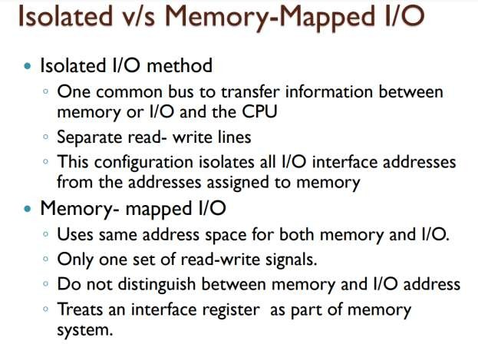
Data Input command- The data input command is the opposite of the data output. In this case the interface receives on item of data from the peripheral and places it in its buffer register
To communicate with I/O, the processor must communicate with the memory unit. Like the I/O bus, the memory bus contains data, address and read/write control lines.
There are 3 ways that computer buses can be used to communicate with memory and I/O:
  Use two Separate buses , one for memory and other for I/O.
  Use one common bus for both memory and I/O but separate control lines for each.
  Use one common bus for memory and I/O with common control lines

